Slide 1
Artificial Intelligence: Representation: Logic
Santosh GSK

Slide 2
State-space representation
In Search Strategies, the states are represented as
Atomic representation
Treated as black box
Many factors are ignored, e.g., gas in car, money available for toll, etc.
To include more factors in our state representation, we have
Factored Representation

Slide 3
Factored Representation
Each state will be represented with
Factors
Each factor can be a Boolean or real-valued variable
E.g., City Arad can now be represented as
{“lat”: 46.1866, “lon”: 21.3123, “has_gas_till_next_station”: yes}

Slide 4
Factored Representation
Why do we need Factored representation
To reason about steps
To learn new knowledge about the environment
To adapt to changes to the existing knowledge
Accept new tasks in the form of explicit goals
To overcome partial observability of environment
E.g., Arad to Bucharest via Sibiu
If Sibiu has road blocked, then the agent should take a different path
i.e., to build Knowledge-based Agents

Slide 5
Knowledge-based Agents
Solving problems by
Representing the knowledge in state-space
Reasoning about the solution in logical steps

Slide 6
Knowledge-based Agents
Central Component: Knowledge Base (KB)
KB – set of sentences, not the English sentences
Sentence
representation of knowledge in a language called Knowledge representation language
Represents an axiom, when the sentence is taken as given without being derived from other sentences
TELL operation: Add new sentences to the knowledge base
ASK operation: Query what is known

Slide 7
Knowledge-based Agents
Each time a knowledge-based agent is called, it does three things
TELL – the Knowledge Base about the percepts (inputs)
ASK – the Knowledge Base what action it should perform.
Extensive reasoning about the outcomes of possible action and current state
TELL – the Knowledge Base about selected action (to update) and agent executes the action

Slide 8
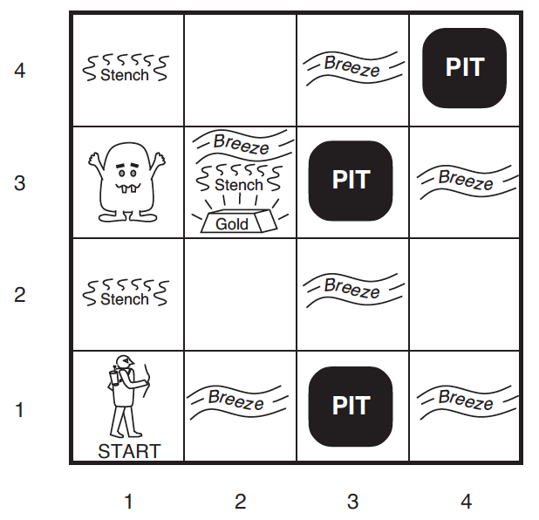
Example: Knowledge-based Agents
Wumpus World

Slide 9
Wumpus World
Defining the task environment (PEAS)
Performance Measure:
+1000 for climbing out with gold,
-1000 for falling into a pit or being eaten by Wumpus,
-1 for each action taken and
-10 for using an arrow
Environment: 4x4 grid of rooms. Always starts at [1, 1] facing right. The location of Wumpus and Gold are random. Agent dies if entered a pit or live Wumpus.

Slide 10
Wumpus World
Actuators –
Forward,
TurnLeft by 90,
TurnRight by 90,
Grab – pick gold if present,
Shoot – fire an arrow, it either hits a wall or kills wumpus. Agent has only one arrow.
Climb – Used to climb out of cave, only from [1, 1]

Slide 11
Wumpus World
Sensors. The agent has five sensors
Stench: In all adjacent (but not diagonal) squares of Wumpus
Breeze: In all adjacent (but not diagonal) squares of a pit
Glitter: In the square where gold is
Bump: If agent walks into a wall
Scream: When Wumpus is killed, it can be perceived everywhere
Percept Format: [Stench?, Breeze?, Glitter?, Bump?, Scream?]
E.g., [Stench, Breeze, None, None, None]

Slide 12
Wumpus World
Goal: Discover the location of Wumpus, Pits and Gold so that the agent can navigate to Gold without falling prey to Wumpus or Pits
This would be agent’s knowledge for transition
Requires a configuration of the environment to do logical reasoning

Slide 13
Wumpus World
Symbolic Notation
A = Agent
B = Breeze
G = Glitter, Gold
OK = Safe Square
P = Pit
S = Stench
V = Visited
W = Wumpus

Slide 14
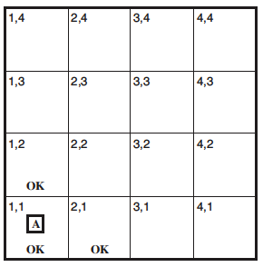
Wumpus World
Percept 1: [None, None, None, None, None]
Action: Forward

Slide 15
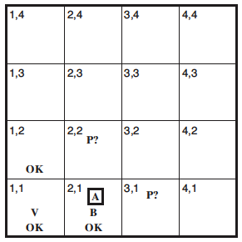
Wumpus World
Percept 2: [None, Breeze, None, None, None]
Action: Move to 1, 2 (the other non-visited OK state)

Slide 16
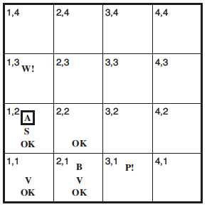
Wumpus World
Percept 3: [Stench, None, None, None, None]
Action: Move to [2, 2]

Slide 17
Wumpus World
Logical Agents: combine the current percept with the existing knowledge (percept history) and do logical reasoning in identifying state information

Slide 18
Logic
Reasoning conducted or assessed according to available knowledge about the domain
Syntax: Every sentence in our knowledge base are expressed according to a syntax of the representing language.
E.g., in Arithmetic, “x + y = 4” is a well-formed sentence, “xy+4=“ is not

Slide 19
Logic – Semantics
Semantics: Meaning of sentence. They define the truth of a sentence according to a possible world.
E.g., in a world where x=2, y=2, “x + y = 4” is a true sentence, whereas in a world where x=1, y=1, the same sentence is not true
In standard Logic, every sentence has to be either True or False but cannot be in between

Slide 20
Logic – Model
Model: Any possible world. Not necessarily the reality. Any combination of assignment of truth values to sentences in our KB.
E.g., Two sentences S1 and S2 in our KB.
Possible models: m1: {S1: True, S2: True}, m2: {S1: False, S2: True}, m3: {S1:True, S2: False}, m4: {S1:False, S2:False}
S1 is true in m1, m3 → m1 satisfies S1 or m3 satisfies S1
M(S1) is set of models that satisfy S1, i.e., [m1, m3]

Slide 21
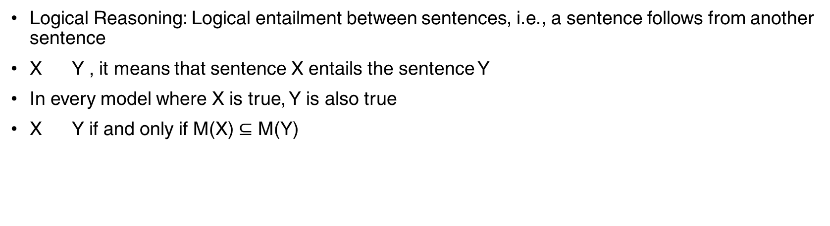
Logic – Entailment
Logical Reasoning: Logical entailment between sentences, i.e., a sentence follows from another sentence
X Y , it means that sentence X entails the sentence Y
In every model where X is true, Y is also true
X Y if and only if M(X) $⊆$ M(Y)

Slide 22
Logic – Entailment
Example: In Wumpus World, the agent is in [2,1] and detected a breeze
The agent is interested in squares [1, 2], [2, 2], [3, 1] for next move.
Now, each square might or might not contain a pit (total 2³ = 8 possible models)
Our KB tells us that in [1, 1] we didn’t receive a breeze and hence [2, 1] doesn’t have a pit

Slide 23
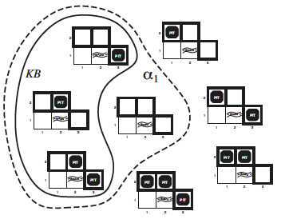
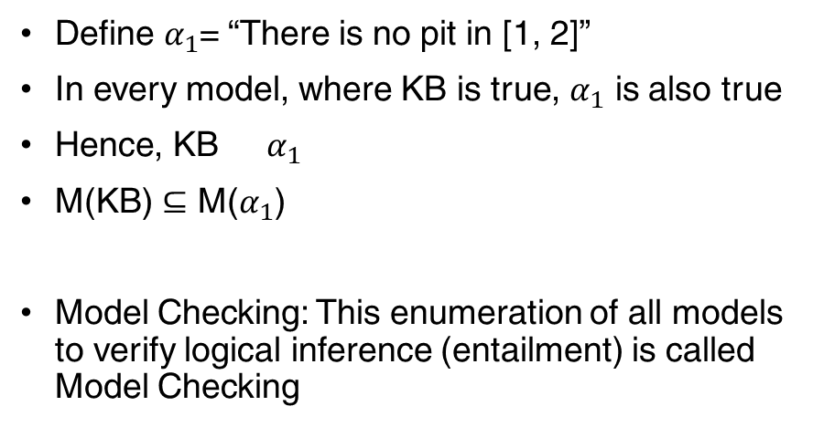
Logic – Entailment
Define $α_{1}$= “There is no pit in [1, 2]”
In every model, where KB is true, $α_{1}$ is also true
Hence, KB $α_{1}$
M(KB) $⊆$ M($α_{1}$)
Model Checking: This enumeration of all models to verify logical inference (entailment) is called Model Checking

Slide 24
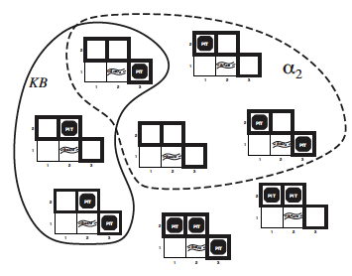
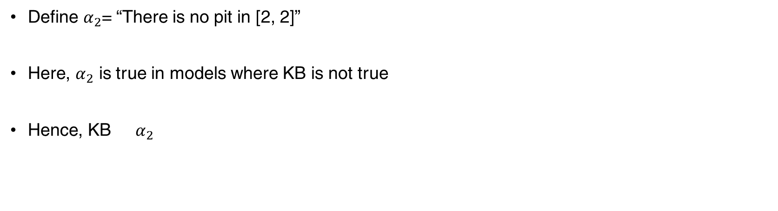
Logic – Entailment
Define $α_{2}$= “There is no pit in [2, 2]”
Here, $α_{2}$ is true in models where KB is not true
Hence, KB $α_{2}$

Slide 25
Logic – Entailment
Sound – An inference algorithm that derives only entailed sentences
E.g., Model Checking is a sound inference procedure
Completeness – An inference algorithm is complete if it can derive any sentence that is entailed
If KB is true, any sentence derived using Sound inference procedure is also true in real world.

Slide 26
Logic - Grounding
Grounding – connection between logical reasoning and real environment in which agent exists
How do we know that KB is true in the real world?
Agent’s sensors create the connection
Agent creates sentence from percept (e.g., smell in wumpus world)
This sentence when stored in Knowledge base will be true in real world
However, the existing Knowledge Base’s sentences like “Wumpus cause smell in adjacent squares” is not a direct representation of percept but is a general rule. Such rules can be learned.

Slide 27
Propositional Logic
A simple representation language for building knowledge-based agents
Proposition Symbol – A symbol that stands for a proposition.
E.g., W_{1,3} – “Wumpus in [1,3]” is a proposition and W_{1,3} is the symbol
Proposition can be true or false
Usually represented with uppercase letter and may contain other letters or subscripts. E.g., P, Q, R, W_{1,3}, North
Two proposition symbols have fixed meaning
True – always true proposition
False – always false proposition

Slide 28
Propositional Logic – Syntax
Syntax – Defines the language for allowable sentences
Atomic Sentence – consist of a single propositional symbol
Complex Sentence – Constructed from atomic sentences using parenthesis and logical connectives

Slide 29
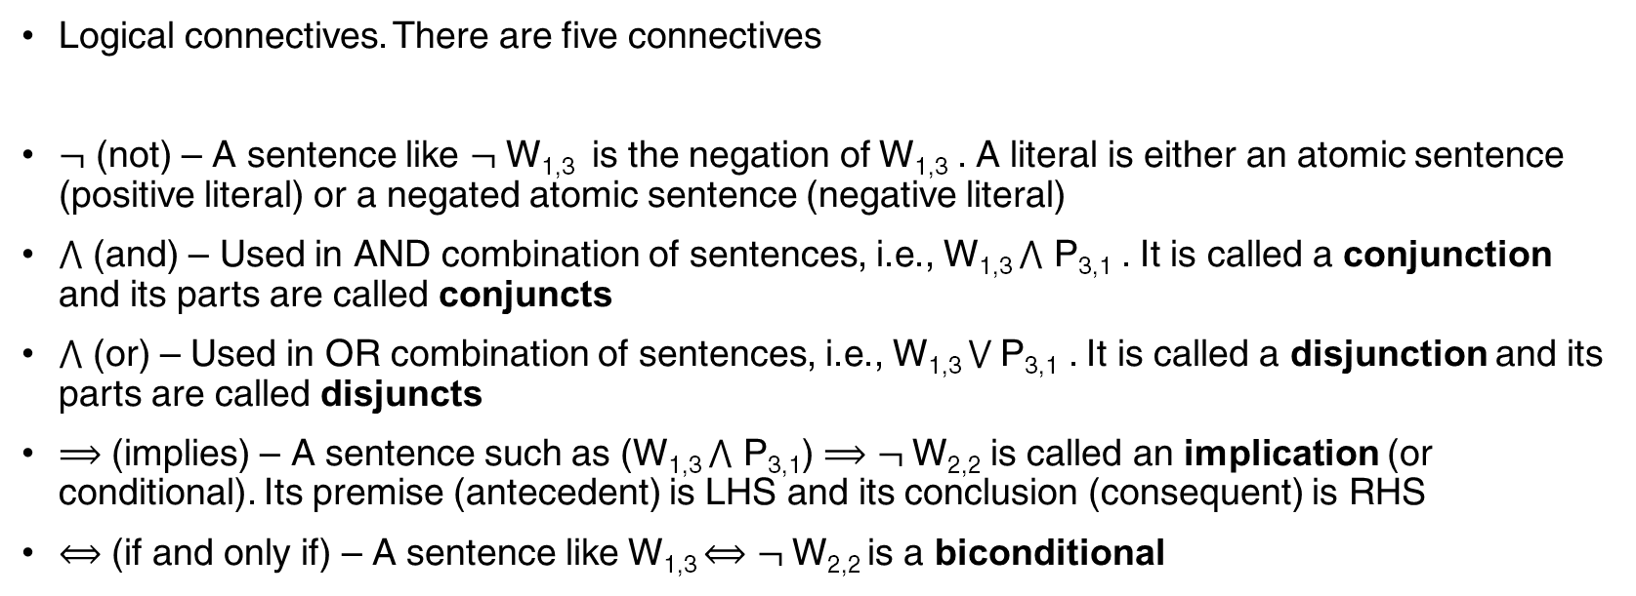
Propositional Logic – Syntax
Logical connectives. There are five connectives
$¬$ (not) – A sentence like $¬$ W_{1,3} is the negation of W_{1,3} . A literal is either an atomic sentence (positive literal) or a negated atomic sentence (negative literal)
$⋀$ (and) – Used in AND combination of sentences, i.e., W_{1,3} $⋀$ P_{3,1} . It is called a conjunction and its parts are called conjuncts
$⋀$ (or) – Used in OR combination of sentences, i.e., W_{1,3} $⋁$P_{3,1} . It is called a disjunction and its parts are called disjuncts
$⟹$ (implies) – A sentence such as (W_{1,3} $⋀$ P_{3,1}) $⟹$ $¬$W_{2,2} is called an implication (or conditional). Its premise (antecedent) is LHS and its conclusion (consequent) is RHS
$⟺$ (if and only if) – A sentence like W_{1,3} $⟺$ $¬$W_{2,2} is a biconditional

Slide 30
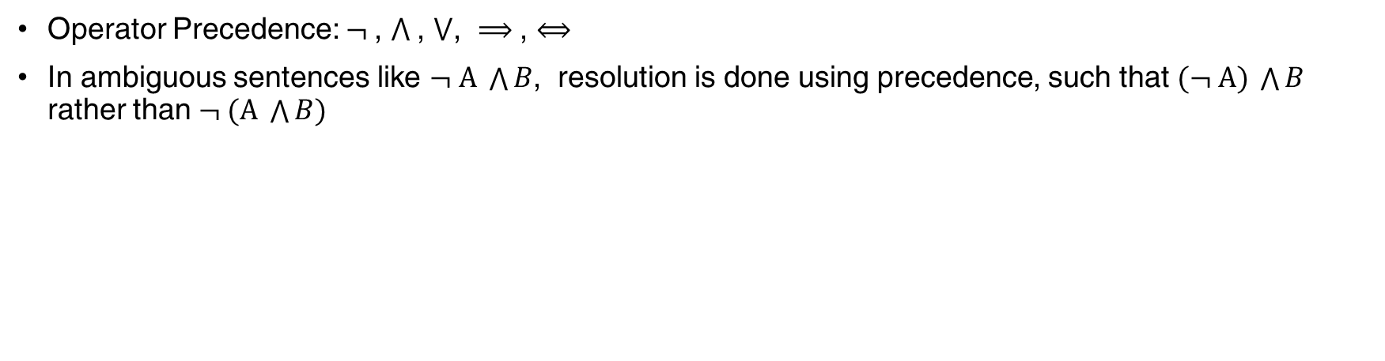
Propositional Logic – Syntax
Operator Precedence: $¬$, $⋀$, $⋁$, $⟹$, $⟺$
In ambiguous sentences like $¬ A \bigwedge{B}$, resolution is done using precedence, such that $(¬ A) \bigwedge{B}$ rather than $¬ (A \bigwedge{B)}$

Slide 31
Propositional Logic – Semantics
Semantics defines the rules for determining the truth of a sentence w.r.t a particular model
E.g., sentences in knowledge base are {P1, P2, P3}, a possible model
m1 = {P1 = false, P2 = true, P3 = false}, a model provides truth values for proposition symbols

Slide 32
Propositional Logic – Semantics
Semantics must specify how to compute the truth value of any sentence, given a model
Compute the truth of atomic sentences and
Compute the truth of sentences formed with five connectives
The truth of atomic sentences is given by the model

Slide 33
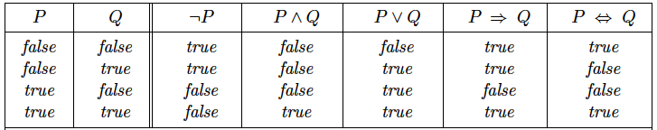
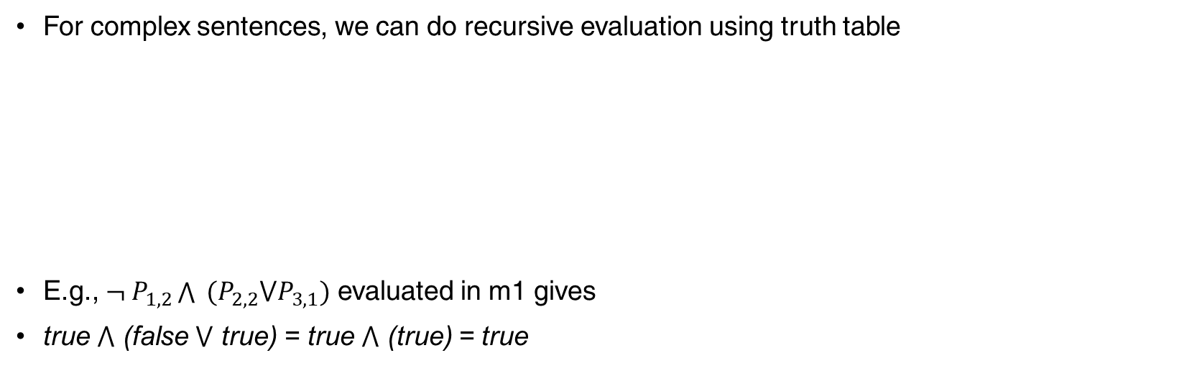
Propositional Logic – Semantics
For complex sentences, we can do recursive evaluation using truth table
E.g., $¬ P_{1, 2}\bigwedge{ (P_{2,2}{⋁P}_{3,1})}$ evaluated in m1 gives
true $⋀$ (false $⋁$ true) = true $⋀$ (true) = true

Slide 34
Propositional Logic – Example KB
A simple KB for wumpus world.
For each [x, y] location
P_{x,y} is true if there is a pit in [x, y]
W_{x,y} is true if there is a wumpus in [x, y]
B_{x,y} is true if agent perceives a breeze in [x, y]
S_{x,y} is true if agent perceives a stench in [x, y]

Slide 35
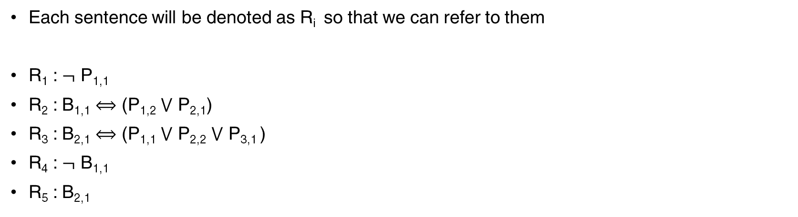
Propositional Logic – Example KB
Each sentence will be denoted as R_{i} so that we can refer to them
R₁ : $¬$ P_{1,1}
R₂ : B_{1,1} $⟺$ (P_{1,2} $⋁$ P_{2,1})
R₃ : B_{2,1} $⟺$ (P_{1,1} $⋁$ P_{2,2} $⋁$ P_{3,1} )
R₄ : $¬$ B_{1,1}
R₅ : B_{2,1}

Slide 36
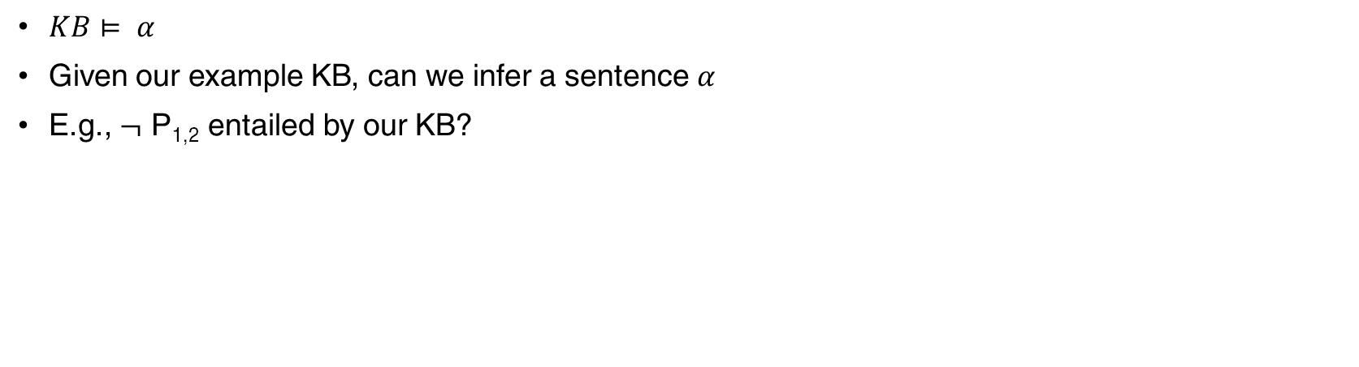
Propositional Logic (PL) – Inference
$KB⊨ α$
Given our example KB, can we infer a sentence $α$
E.g., $¬$ P_{1,2} entailed by our KB?

Slide 37
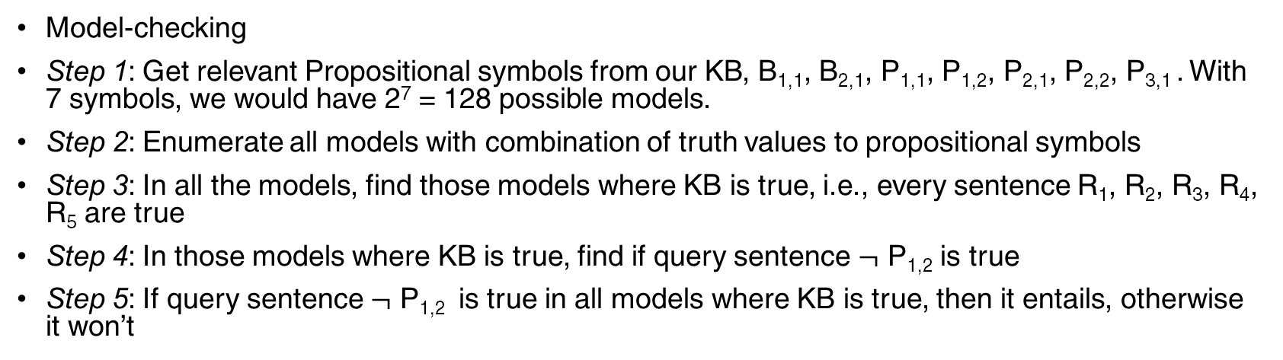
PL Inference - Model Checking
Model-checking
Step 1: Get relevant Propositional symbols from our KB, B_{1,1}, B_{2,1}, P_{1,1}, P_{1,2}, P_{2,1}, P_{2,2}, P_{3,1} . With 7 symbols, we would have 2⁷ = 128 possible models.
Step 2: Enumerate all models with combination of truth values to propositional symbols
Step 3: In all the models, find those models where KB is true, i.e., every sentence R₁, R₂, R₃, R₄, R₅ are true
Step 4: In those models where KB is true, find if query sentence $¬$ P_{1,2} is true
Step 5: If query sentence $¬$ P_{1,2} is true in all models where KB is true, then it entails, otherwise it won’t

Slide 38
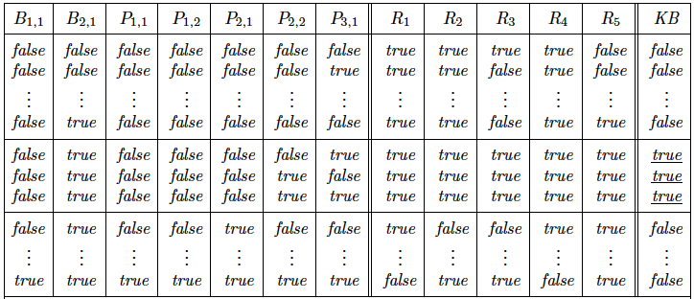
PL Inference - Model Checking

Slide 39
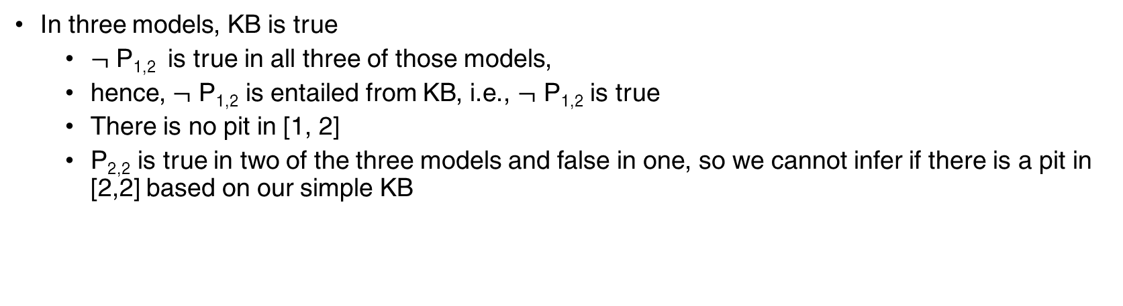
PL Inference - Model Checking
In three models, KB is true
$¬$ P_{1,2} is true in all three of those models,
hence, $¬$ P_{1,2} is entailed from KB, i.e., $¬$ P_{1,2} is true
There is no pit in [1, 2]
P_{2,2} is true in two of the three models and false in one, so we cannot infer if there is a pit in [2,2] based on our simple KB

Slide 40
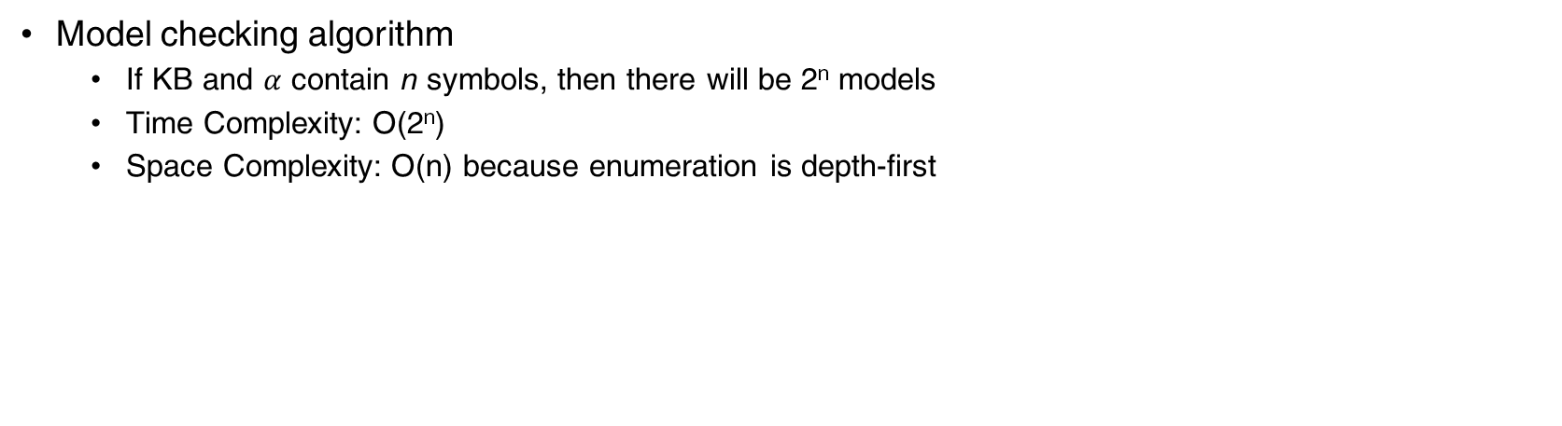
PL Inference - Model Checking
Model checking algorithm
If KB and $α$ contain n symbols, then there will be 2^{n} models
Time Complexity: O(2^{n})
Space Complexity: O(n) because enumeration is depth-first

Slide 41
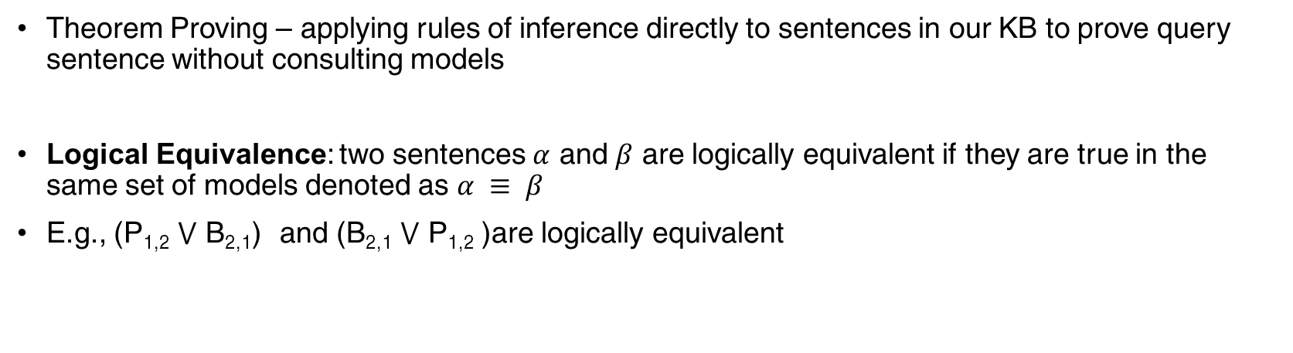
PL Inference - Theorem Proving
Theorem Proving – applying rules of inference directly to sentences in our KB to prove query sentence without consulting models
Logical Equivalence: two sentences $α$ and $β$ are logically equivalent if they are true in the same set of models denoted as $α ≡ β$
E.g., (P_{1,2} $⋁$ B_{2,1}) and (B_{2,1} $⋁$ P_{1,2} )are logically equivalent

Slide 42
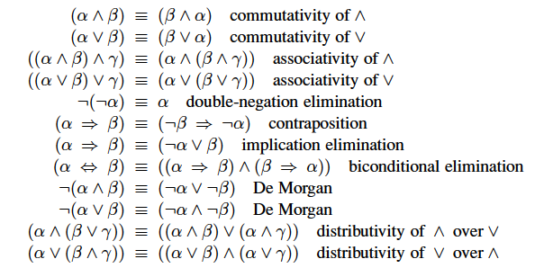
PL Inference - Theorem Proving
Logical Equivalence

Slide 43
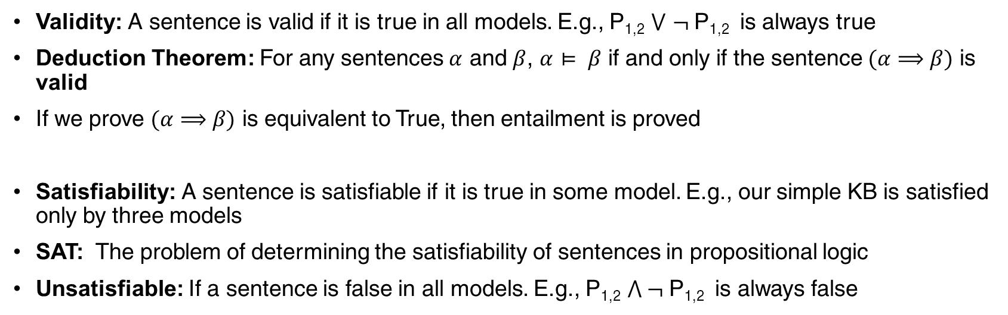
PL Inference - Theorem Proving
Validity: A sentence is valid if it is true in all models. E.g., P_{1,2} $⋁$ $¬$P_{1,2} is always true
Deduction Theorem: For any sentences $α$ and $β$, $α$ $⊨ β$ if and only if the sentence $(α$ $⟹$ $β)$ is valid
If we prove $(α$ $⟹$ $β)$ is equivalent to True, then entailment is proved
Satisfiability: A sentence is satisfiable if it is true in some model. E.g., our simple KB is satisfied only by three models
SAT: The problem of determining the satisfiability of sentences in propositional logic
Unsatisfiable: If a sentence is false in all models. E.g., P_{1,2} $⋀ ¬$P_{1,2} is always false

Slide 44
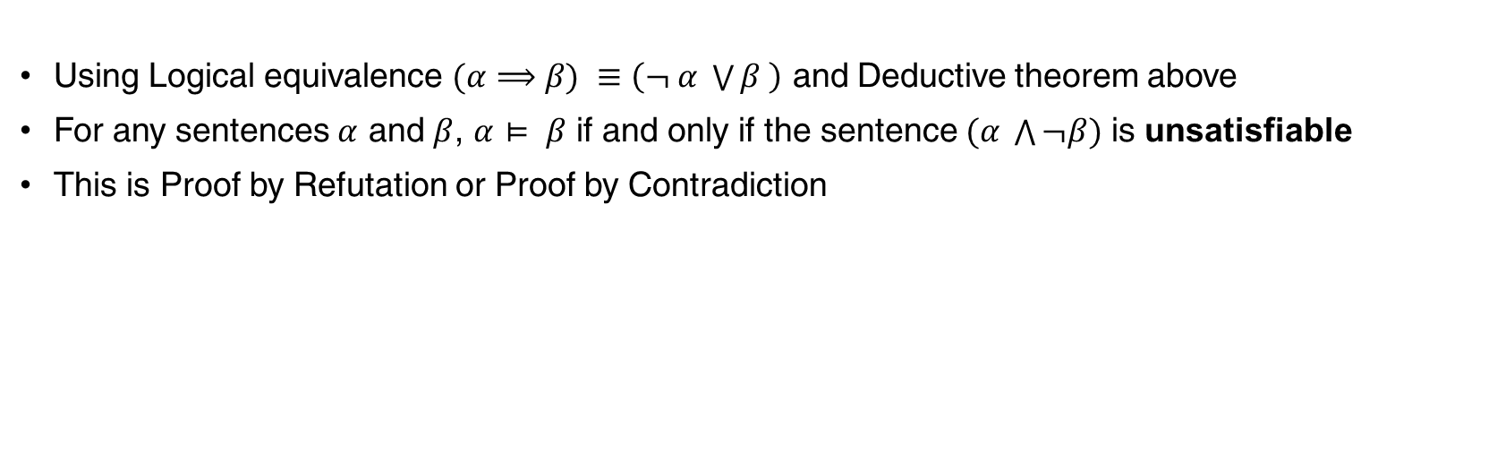
PL Inference – Theorem Proving
Using Logical equivalence $(α$ $⟹$ $β) ≡\left(¬ α \bigvee{β} \right)$ and Deductive theorem above
For any sentences $α$ and $β$, $α$ $⊨ β$ if and only if the sentence $(α \bigwedge{¬β})$ is unsatisfiable
This is Proof by Refutation or Proof by Contradiction

Slide 45
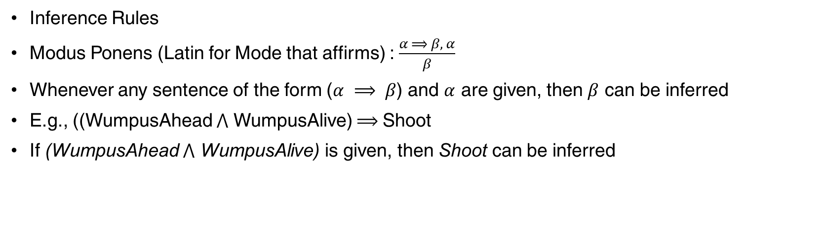
PL Inference – Theorem Proving
Inference Rules
Modus Ponens (Latin for Mode that affirms) : $\frac{α ⟹ β, α}{β}$
Whenever any sentence of the form ($α ⟹ β$) and $α$ are given, then $β$ can be inferred
E.g., ((WumpusAhead $⋀$ WumpusAlive) $⟹$Shoot
If (WumpusAhead $⋀$ WumpusAlive) is given, then Shoot can be inferred

Slide 46
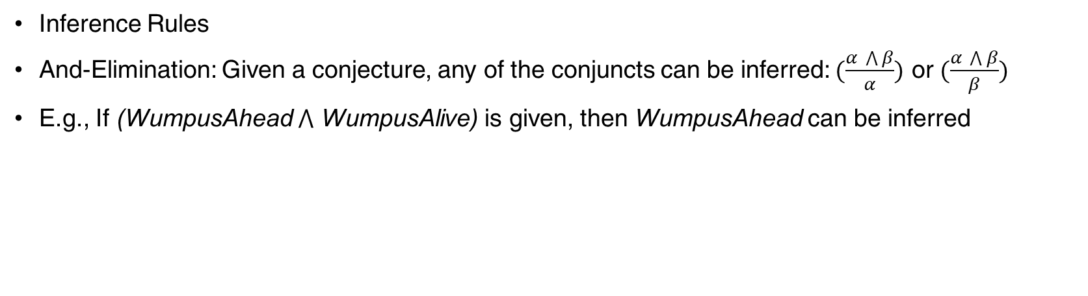
PL Inference – Theorem Proving
Inference Rules
And-Elimination: Given a conjecture, any of the conjuncts can be inferred: $(\frac{α \bigwedge{β}}{α})$ or $(\frac{α \bigwedge{β}}{β})$
E.g., If (WumpusAhead $⋀$ WumpusAlive) is given, then WumpusAhead can be inferred

Slide 47
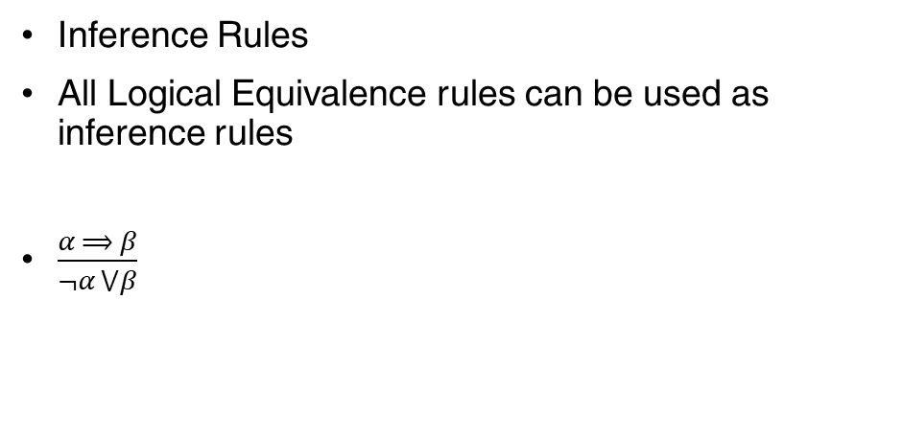
PL Inference – Theorem Proving
Inference Rules
All Logical Equivalence rules can be used as inference rules
$\frac{α ⟹ β}{¬α ⋁β}$

Slide 48
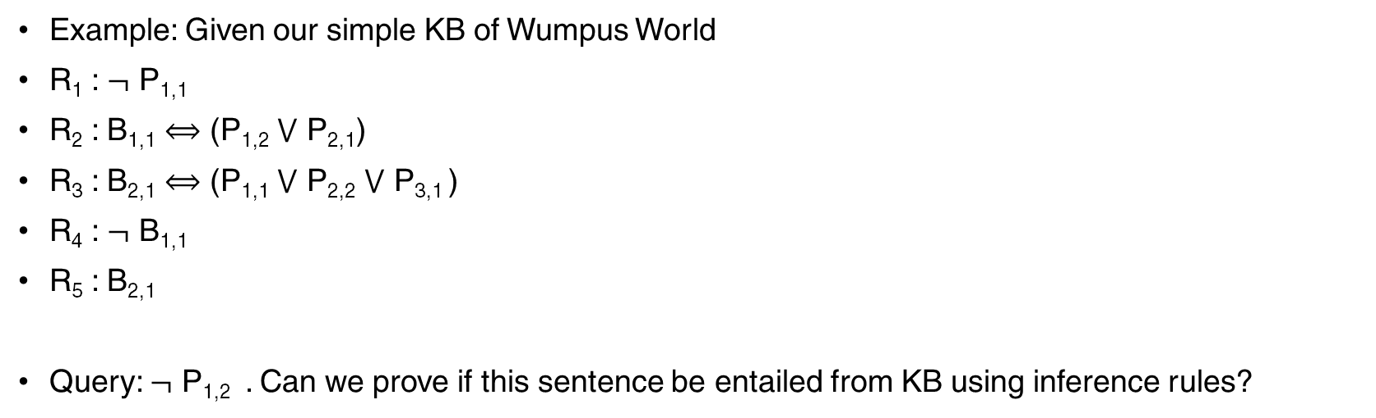
PL Inference – Theorem Proving
Example: Given our simple KB of Wumpus World
R₁ : $¬$ P_{1,1}
R₂ : B_{1,1} $⟺$ (P_{1,2} $⋁$ P_{2,1})
R₃ : B_{2,1} $⟺$ (P_{1,1} $⋁$ P_{2,2} $⋁$ P_{3,1} )
R₄ : $¬$ B_{1,1}
R₅ : B_{2,1}
Query: $¬$ P_{1,2} . Can we prove if this sentence be entailed from KB using inference rules?

Slide 49
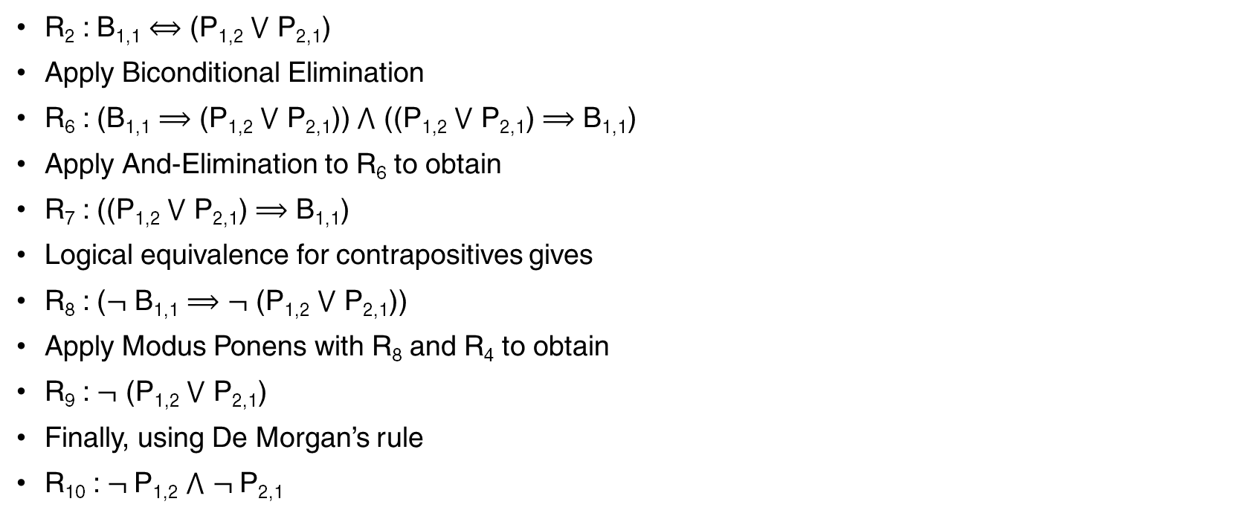
PL Inference – Theorem Proving
R₂ : B_{1,1} $⟺$ (P_{1,2} $⋁$ P_{2,1})
Apply Biconditional Elimination
R₆ : (B_{1,1} $⟹$ (P_{1,2} $⋁$ P_{2,1})) $⋀$ ((P_{1,2} $⋁$ P_{2,1}) $⟹$ B_{1,1})
Apply And-Elimination to R₆ to obtain
R₇ : ((P_{1,2} $⋁$ P_{2,1}) $⟹$ B_{1,1})
Logical equivalence for contrapositives gives
R₈ : ($¬$ B_{1,1} $⟹$ $¬$ (P_{1,2} $⋁$ P_{2,1}))
Apply Modus Ponens with R₈ and R₄ to obtain
R₉ : $¬$ (P_{1,2} $⋁$ P_{2,1})
Finally, using De Morgan’s rule
R₁₀ : $¬$P_{1,2} $⋀$ $¬$P_{2,1}

Slide 50
PL Inference – Theorem Proving
This proof can be efficiently computed using search algorithms we discussed earlier. We need to define the proof problem as
Initial State: the initial knowledge base
Actions: all inference rules that could match the sentences with the top half of inference rule
Result: the bottom half of inference rule
Goal: The state containing the query sentence
In many practical cases, searching a proof can be more efficient because the proof can ignore irrelevant propositions

Slide 51
Limitations of Propositional Logic
Propositional logic identify individual states but fail to associate with objects.
E.g., if there are five gold squares and the task is to visit all of them, it needs bookkeeping on variables or OOPS concept in programming
Doesn’t capture relations within objects
E.g., every pit would have a breeze in adjacent squares need to be written separately for each square, instead a simple relation should be able to encode the knowledge to every pit
E.g., Any sentence in natural language would contain objects (nouns, verbs) and relations (subject, object) between them

Slide 52
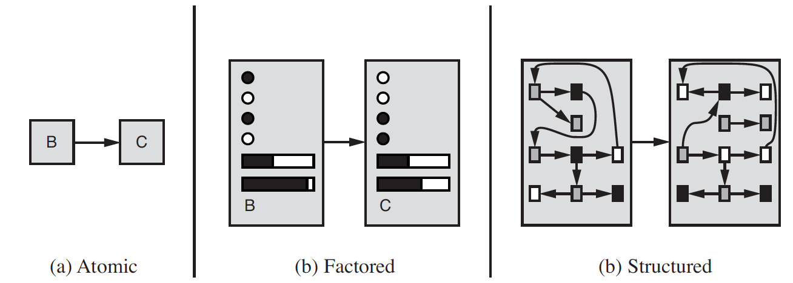
Complexity of Representation
What my actions do?
Search Strategies
Propositional Logic
First Order Logic

Slide 53
Structured Representation
Has three elements
Objects – entities that can be represented as individual states. E.g., people, houses, numbers, etc.
Relations – they can be unary relations or properties of objects such as adjectives, red, round, multistoried, etc. They can be n-ary relations between objects such as brother of, bigger than, inside, part of, etc.
Functions – these are relations where there is only one value for a given input. E.g., father of, best friend, king of. The output of a function is always an object.

Slide 54
Structured Representation
Squares neighboring the wumpus are smelly
Objects: squares, wumpus
Unary Relation (properties of an object): smelly
N-ary Relation (between objects): neighboring
Function: -
One plus two equals three
Objects: One, two, three, one plus two
Unary Relation (properties of an object): -
N-ary Relation (between objects): equals
Function: plus (“plus” when applied to objects “one” and two” gave another object “one plus two”)

Slide 55
First Order Logic
Works on the concept that world consists of objects with certain relations among them that do or do not hold.
Its Syntax and Semantics are built around Objects, Relations and Functions
Primary difference between propositional and first-order logic lies in “ontological commitment” – the assumption about the nature of reality.
Propositional Logic assumes that the world consists of states which can be represented in a set of facts that can either be true or false.
Temporal Logic – assumes that facts hold at particular times and they are ordered
Higher Order Logic – views the relations and functions of first order logic as objects in themselves.

Slide 56
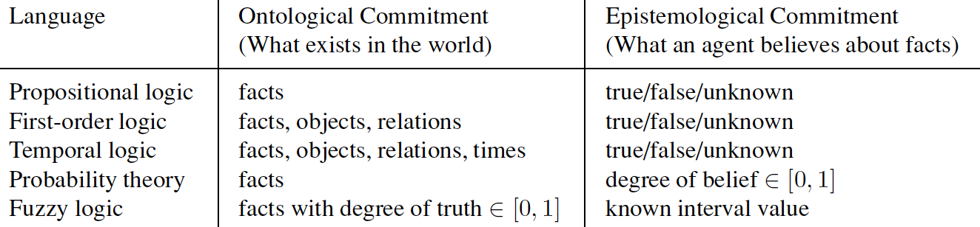
First Order Logic - Comparison

Slide 57
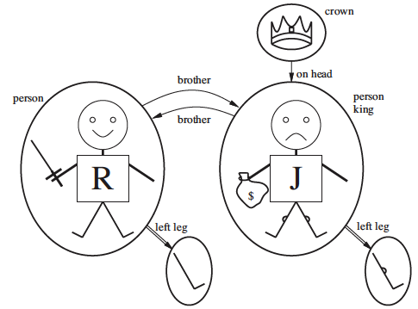
First Order Logic – Example
Domain – Domain of a model is the set of objects or domain elements it contains.
Objects: Richard the Lionheart, Evil King John, Richard’s left leg, John’s left leg, Crown
Relation: A set of tuples of objects that are related
E.g., Brotherhood: {<Richard, John>, <John, Richard>}
OnHead: { <crown, John>}
These are binary relations, relate two objects
Unary relations: “Person”, “King” properties, “King” is True for John but False for Richard
Function: A relation where a given object is related to exactly one object
E.g., LeftLeg(Richard) => Richard’s left leg
LeftLeg(John) => John’s left leg

Slide 58
First Order Logic – Syntax
Symbols: Basic syntactic elements
Three types
Constant Symbols: represent objects
Predicate Symbols: represent relations
Function Symbols: stand for functions
All begin with uppercase, E.g., Brother, OnHead, Person, King, Crown, LeftLeg
Arity: Fixes the number of arguments for predicate and function symbol
Intended Interpretation: In addition to above symbols, an interpretation helps in specifying exactly which objects, relations and functions are referred by the constant, predicate, function symbols.

Slide 59
First Order Logic – Syntax
Term: a Term is a logical expression that refers to an object
Constant symbols are terms
Complex Term: instead of having constant symbols for every object, e.g,. Richard’s left leg, we use function symbols, e.g., LeftLeg, followed by a list of terms in parenthesis. Not a subroutine call

Slide 60
First Order Logic – Syntax
Atomic Sentence: Formed by a predicate symbol optionally followed by a parenthesized list of terms. E.g., Brother(Richard, John) – which means that Richard is the brother of John.
Atomic sentences can have complex terms as arguments. E.g., Married(Father(Richard), Mother(John))
Atomic sentence is true if the Predicate relation holds between the objects in the arguments

Slide 61
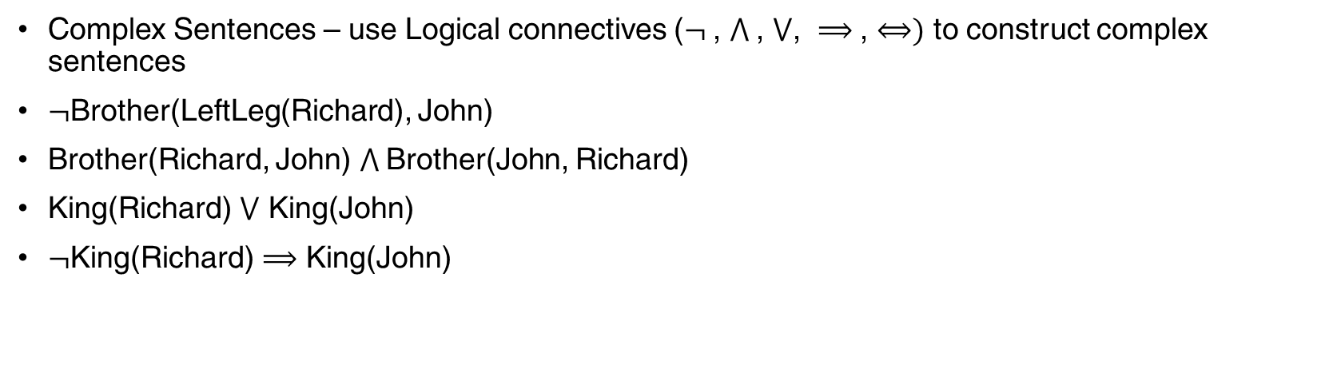
First Order Logic – Syntax
Complex Sentences – use Logical connectives ($¬$, $⋀$, $⋁$, $⟹$, $⟺)$ to construct complex sentences
$¬$Brother(LeftLeg(Richard), John)
Brother(Richard, John) $⋀$Brother(John, Richard)
King(Richard) $⋁$ King(John)
$¬$King(Richard) $⟹$ King(John)

Slide 62
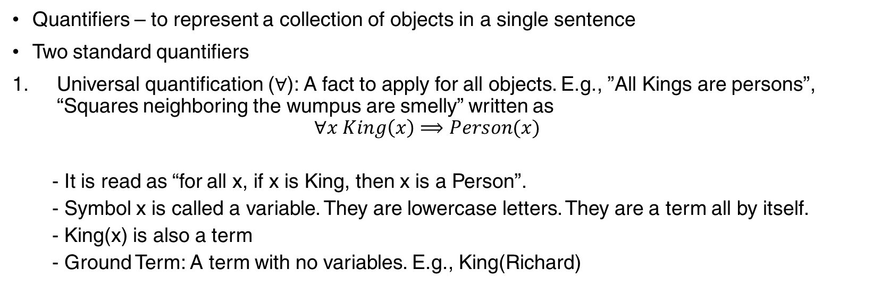
First Order Logic – Syntax
Quantifiers – to represent a collection of objects in a single sentence
Two standard quantifiers
Universal quantification ($∀$): A fact to apply for all objects. E.g., ”All Kings are persons”, “Squares neighboring the wumpus are smelly” written as
$$∀x King\left(x\right)⟹Person(x)$$
- It is read as “for all x, if x is King, then x is a Person”.
- Symbol x is called a variable. They are lowercase letters. They are a term all by itself.
- King(x) is also a term
- Ground Term: A term with no variables. E.g., King(Richard)

Slide 63
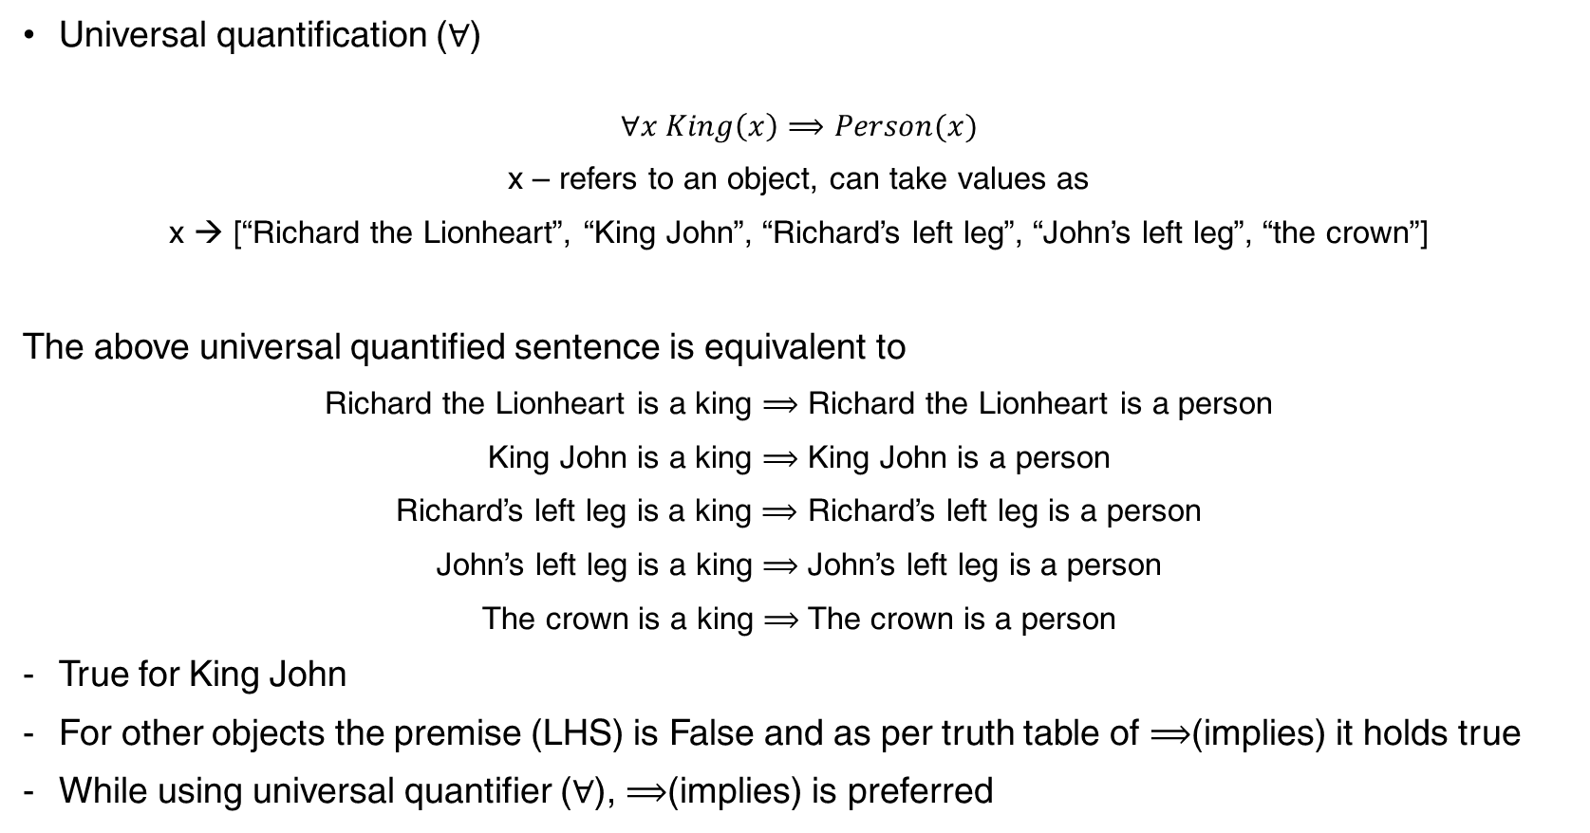
First Order Logic – Syntax
Universal quantification ($∀$)
$$∀x King\left(x\right)⟹Person(x)$$
x – refers to an object, can take values as
x → [“Richard the Lionheart”, “King John”, “Richard’s left leg”, “John’s left leg”, “the crown”]
The above universal quantified sentence is equivalent to
Richard the Lionheart is a king $⟹$ Richard the Lionheart is a person
King John is a king $⟹$ King John is a person
Richard’s left leg is a king $⟹$ Richard’s left leg is a person
John’s left leg is a king $⟹$ John’s left leg is a person
The crown is a king $⟹$ The crown is a person
True for King John
For other objects the premise (LHS) is False and as per truth table of $⟹$(implies) it holds true
While using universal quantifier ($∀$), $⟹$(implies) is preferred

Slide 64
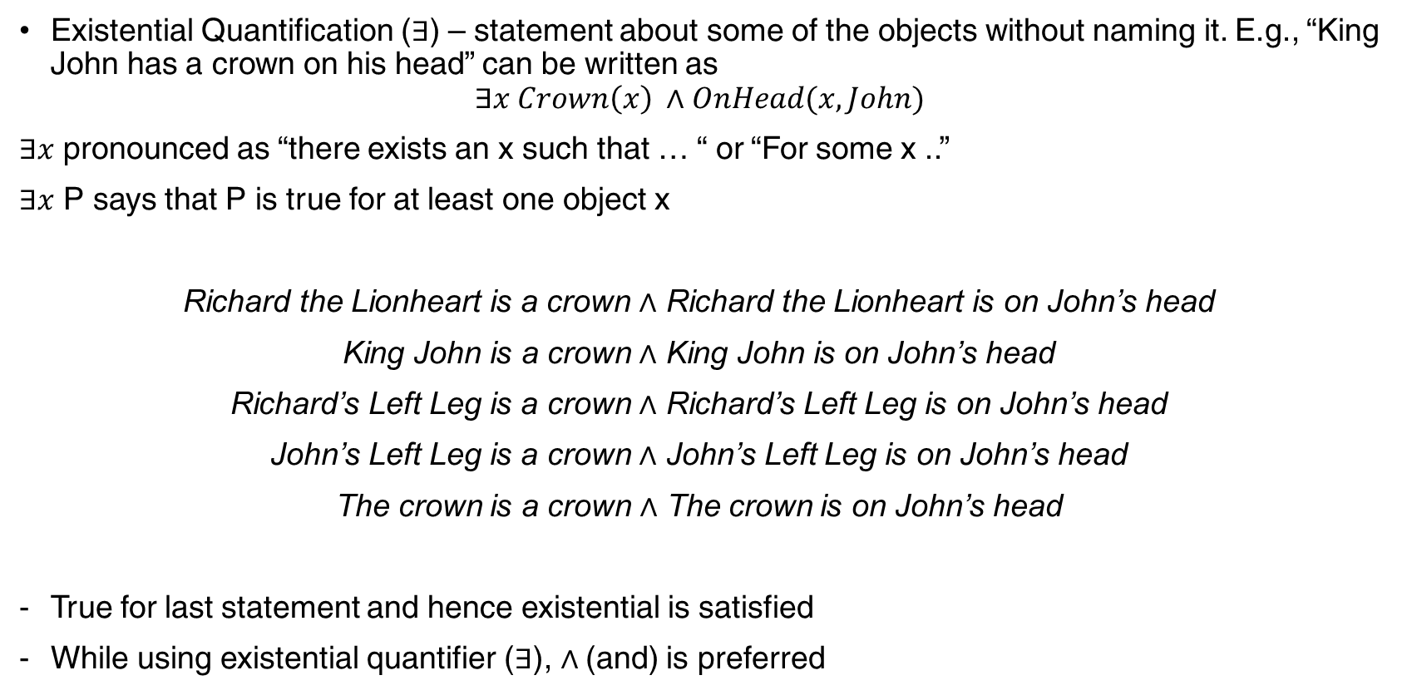
First Order Logic – Syntax
Existential Quantification ($∃$) – statement about some of the objects without naming it. E.g., “King John has a crown on his head” can be written as
$$∃x Crown\left(x\right) ∧OnHead(x, John)$$
$∃x$ pronounced as “there exists an x such that … “ or “For some x ..”
$∃x$ P says that P is true for at least one object x
Richard the Lionheart is a crown $∧$ Richard the Lionheart is on John’s head
King John is a crown $∧$ King John is on John’s head
Richard’s Left Leg is a crown $∧$ Richard’s Left Leg is on John’s head
John’s Left Leg is a crown $∧$ John’s Left Leg is on John’s head
The crown is a crown $∧$ The crown is on John’s head
True for last statement and hence existential is satisfied
While using existential quantifier ($∃$), $∧$(and) is preferred

Slide 65
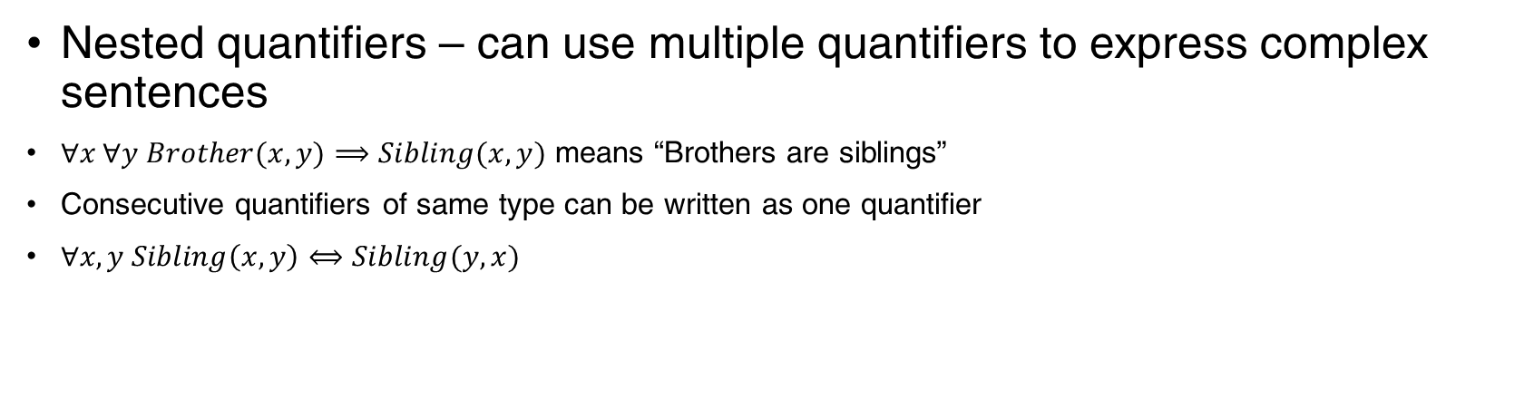
First Order Logic – Syntax
Nested quantifiers – can use multiple quantifiers to express complex sentences
$∀x ∀y Brother(x,y)⟹Sibling(x, y)$ means “Brothers are siblings”
Consecutive quantifiers of same type can be written as one quantifier
$∀x,y Sibling\left(x,y\right)⟺Sibling(y, x)$

Slide 66
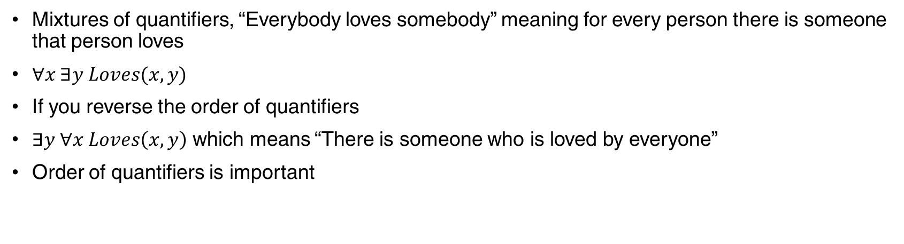
First Order Logic – Syntax
Mixtures of quantifiers, “Everybody loves somebody” meaning for every person there is someone that person loves
$∀x ∃y Loves(x, y)$
If you reverse the order of quantifiers
$∃y ∀x Loves\left(x, y\right)$ which means “There is someone who is loved by everyone”
Order of quantifiers is important

Slide 67
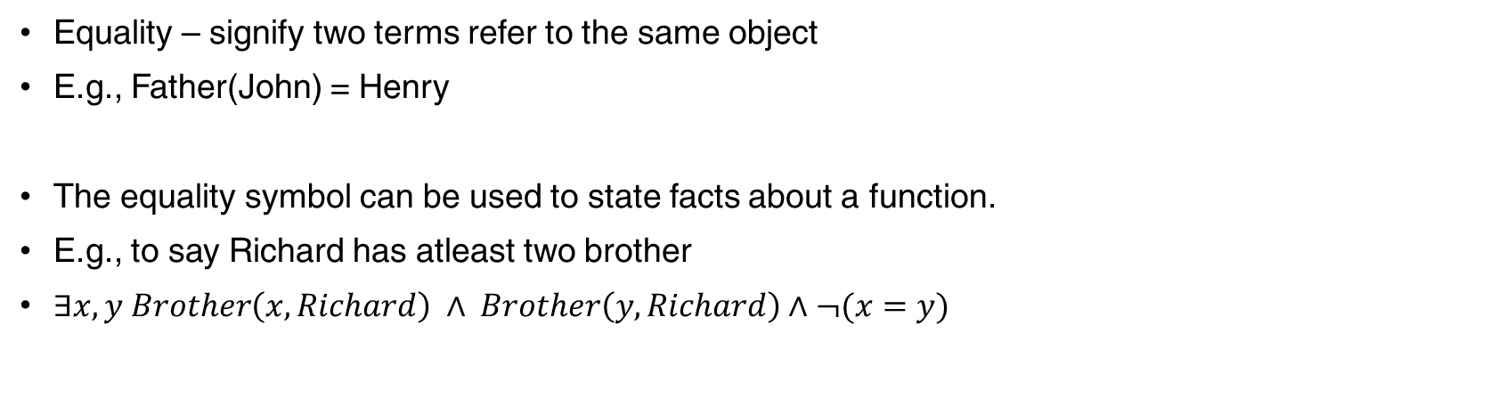
First Order Logic – Syntax
Equality – signify two terms refer to the same object
E.g., Father(John) = Henry
The equality symbol can be used to state facts about a function.
E.g., to say Richard has atleast two brother
$∃x, y Brother\left(x, Richard\right) ∧ Brother\left(y, Richard\right)∧¬(x=y)$

Slide 68
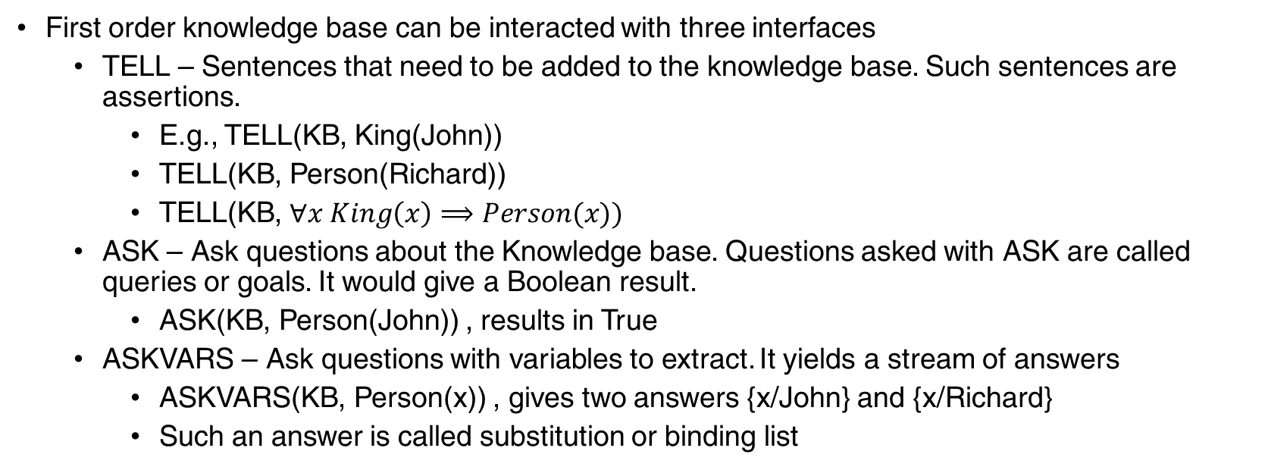
First Order Logic – Knowledge Base Usage
First order knowledge base can be interacted with three interfaces
TELL – Sentences that need to be added to the knowledge base. Such sentences are assertions.
E.g., TELL(KB, King(John))
TELL(KB, Person(Richard))
TELL(KB, $∀x King\left(x\right)⟹Person(x))$
ASK – Ask questions about the Knowledge base. Questions asked with ASK are called queries or goals. It would give a Boolean result.
ASK(KB, Person(John)) , results in True
ASKVARS – Ask questions with variables to extract. It yields a stream of answers
ASKVARS(KB, Person(x)) , gives two answers {x/John} and {x/Richard}
Such an answer is called substitution or binding list

Slide 69
First Order Logic – Inference
First order logic has sentences with quantifiers which makes it hard for inference
First order inference can be done by
reducing the knowledge base to propositional logic and
use propositional inference techniques

Slide 70
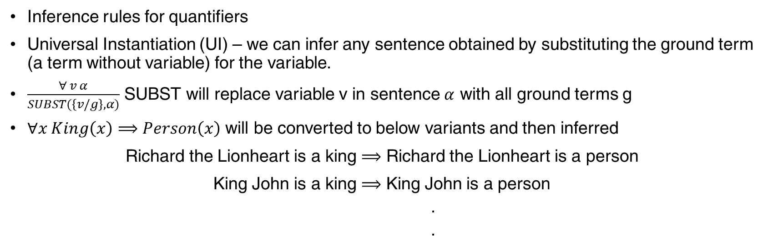
First Order Logic - Inference
Inference rules for quantifiers
Universal Instantiation (UI) – we can infer any sentence obtained by substituting the ground term (a term without variable) for the variable.
$\frac{∀ v α}{SUBST(\left\{v/g\right\},α)}$ SUBST will replace variable v in sentence $α$ with all ground terms g
$∀x King\left(x\right)⟹Person\left(x\right)$ will be converted to below variants and then inferred
Richard the Lionheart is a king $⟹$ Richard the Lionheart is a person
King John is a king $⟹$ King John is a person
.
.

Slide 71
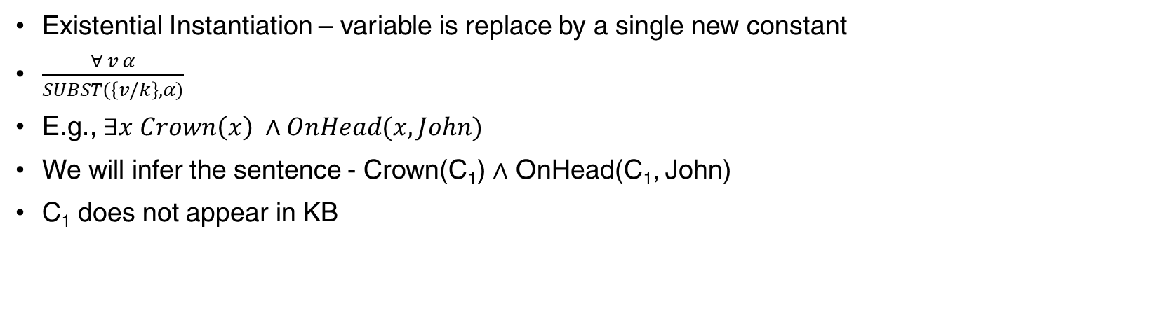
First Order Logic - Inference
Existential Instantiation – variable is replace by a single new constant
$\frac{∀ v α}{SUBST(\left\{v/k\right\},α)}$
E.g., $∃x Crown\left(x\right) ∧OnHead(x, John)$
We will infer the sentence - Crown(C₁) $∧$ OnHead(C₁, John)
C₁ does not appear in KB

Slide 72
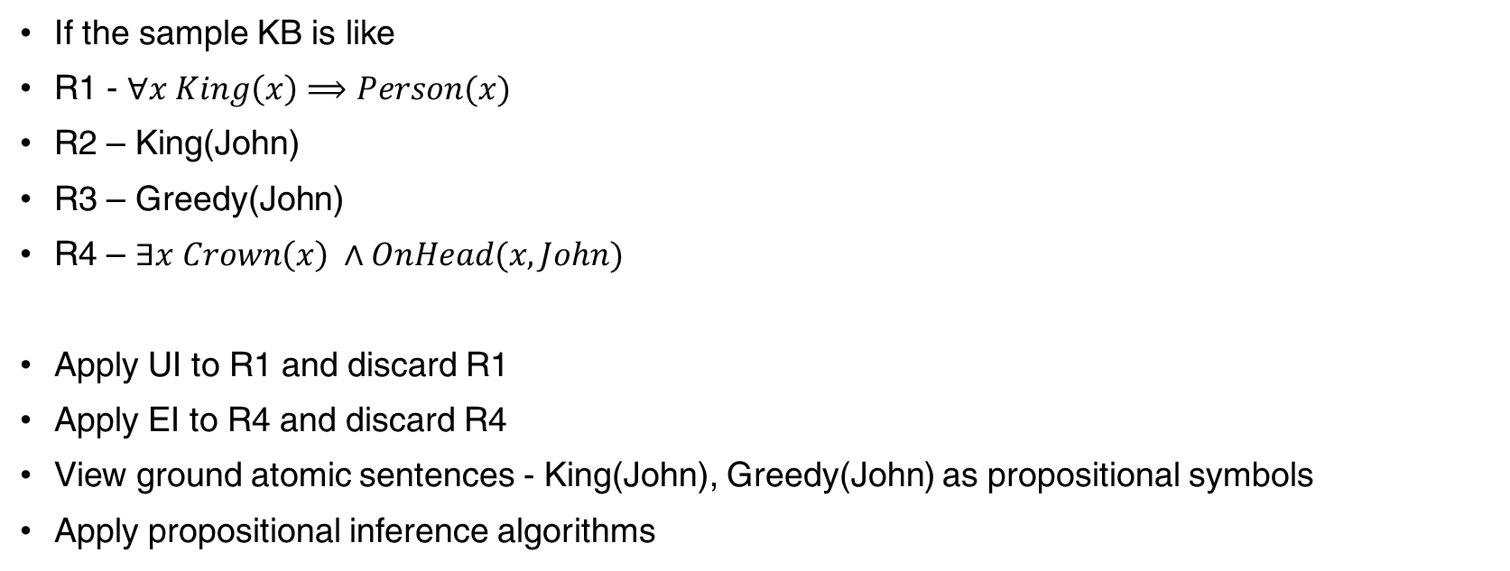
First Order Logic – Reduction to propositional
If the sample KB is like
R1 - $∀x King\left(x\right)⟹Person(x)$
R2 – King(John)
R3 – Greedy(John)
R4 – $∃x Crown\left(x\right) ∧OnHead(x, John)$
Apply UI to R1 and discard R1
Apply EI to R4 and discard R4
View ground atomic sentences - King(John), Greedy(John) as propositional symbols
Apply propositional inference algorithms

Slide 73
Thank You!
In our next session:

